Slide 1
BITS Pilani presentation
K. Venkata Ratnam
Mathematics

Slide 2
Course Number : SS ZC416
Course Title: MATHEMATICAL FOUNDATIONS
FOR DATA SCIENCE
Lecture No. :13

Slide 3
Problem
Let R be the relation on the set of ordered pairs of positive integers such that ((a, b), (c, d)) ∈ R if and only if
a + d = b + c.
a) Show that R is an equivalence relation.
b) What is the equivalence class of (1, 2) with respect to the equivalence relation?
c) Give an interpretation of the equivalence classes for the equivalence relation R.

Slide 4
Solution
R is reflexive: Suppose (a, b) is an ordered pair in Z × Z. [We must show that (a, b) R (a, b).]
We have a + b = a + b. Thus, by definition of R, (a, b) R (a, b).
R is symmetric: Suppose (a, b) and (c, d) are two ordered pairs in Z × Z and (a, b) R (c, d). [We must show that (c, d) R (a, b).] Since (a, b) R (c, d), a + d = b + c. But this implies that b + c = a + d, and so, by definition of R, (c, d) R (a, b).
R is transitive: Suppose (a, b),(c, d), and (e, f) are elements of Z × Z, (a, b) R (c, d), and (c, d) R (e, f). [We must show that (a, b) R (e, f).] Since (a, b) R (c, d), a + d = b + c, which means a − b = c − d, and since (c, d) R (e, f)C, c + f = d + e, which means c − d = e − f. Thus a − b = e − f, which means a + f = b + e, and so, by definition of R, (a, b) R (e, f).

Slide 5
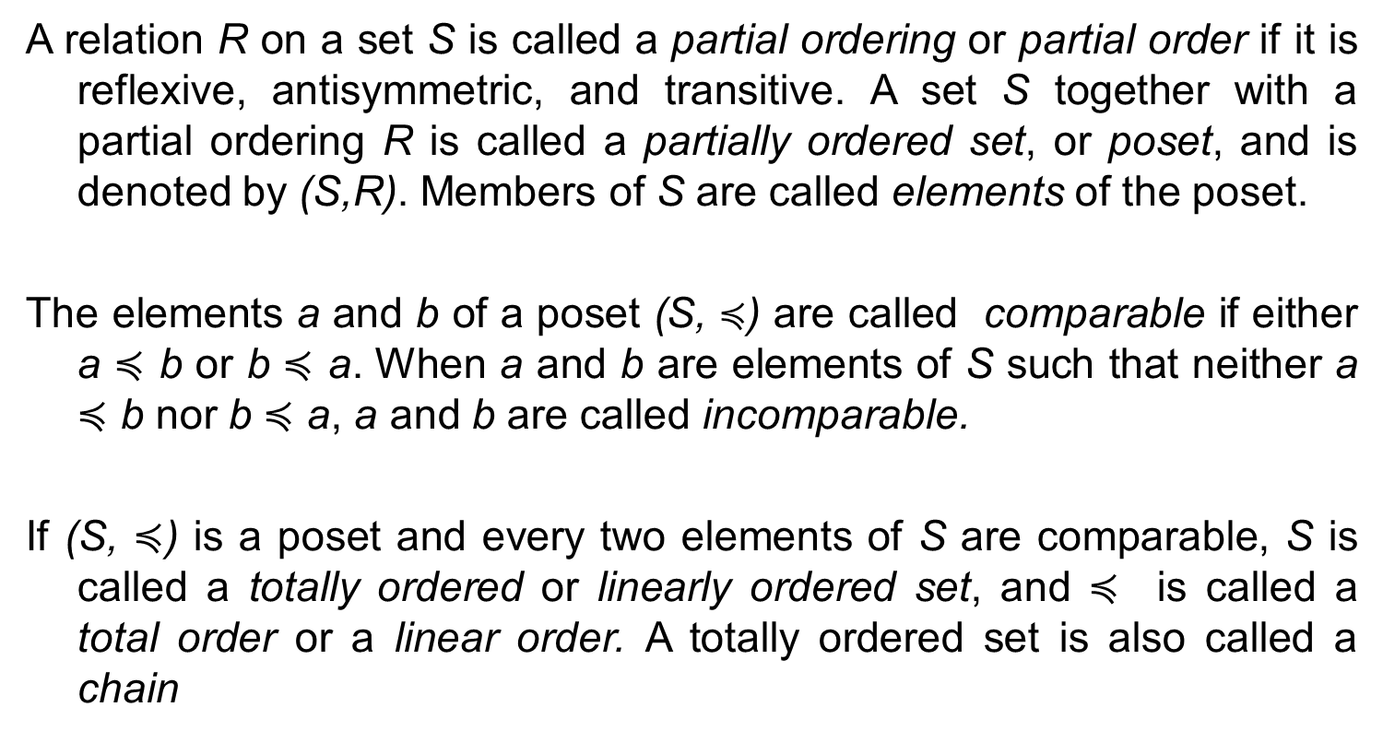
Poset
A relation R on a set S is called a partial ordering or partial order if it is reflexive, antisymmetric, and transitive. A set S together with a partial ordering R is called a partially ordered set, or poset, and is denoted by (S,R). Members of S are called elements of the poset.
The elements a and b of a poset (S, $≼$) are called comparable if either a $≼$ b or b $≼$ a. When a and b are elements of S such that neither a $≼$ b nor b $≼$ a, a and b are called incomparable.
If (S, $≼$) is a poset and every two elements of S are comparable, S is called a totally ordered or linearly ordered set, and $≼$ is called a total order or a linear order. A totally ordered set is also called a chain

Slide 6
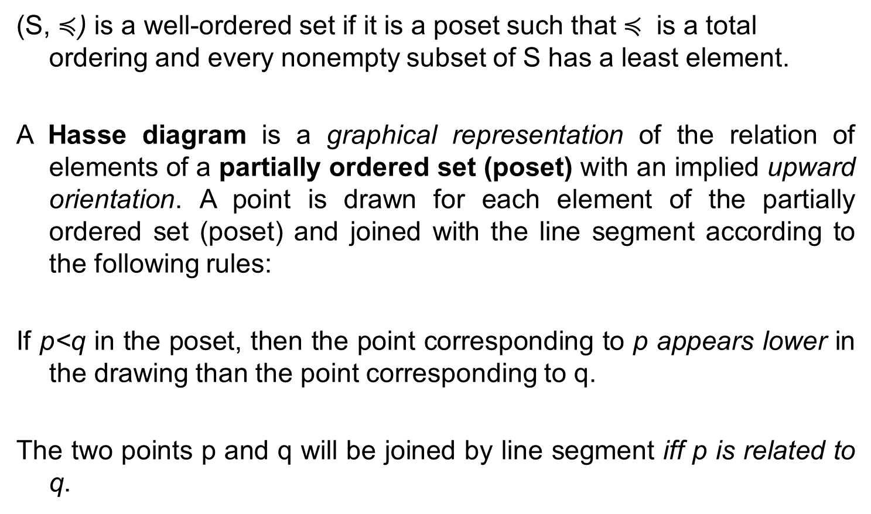
Hasse diagram
(S, $≼$) is a well-ordered set if it is a poset such that $≼$ is a total ordering and every nonempty subset of S has a least element.
A Hasse diagram is a graphical representation of the relation of elements of a partially ordered set (poset) with an implied upward orientation. A point is drawn for each element of the partially ordered set (poset) and joined with the line segment according to the following rules:
If p<q in the poset, then the point corresponding to p appears lower in the drawing than the point corresponding to q.
The two points p and q will be joined by line segment iff p is related to q.

Slide 7
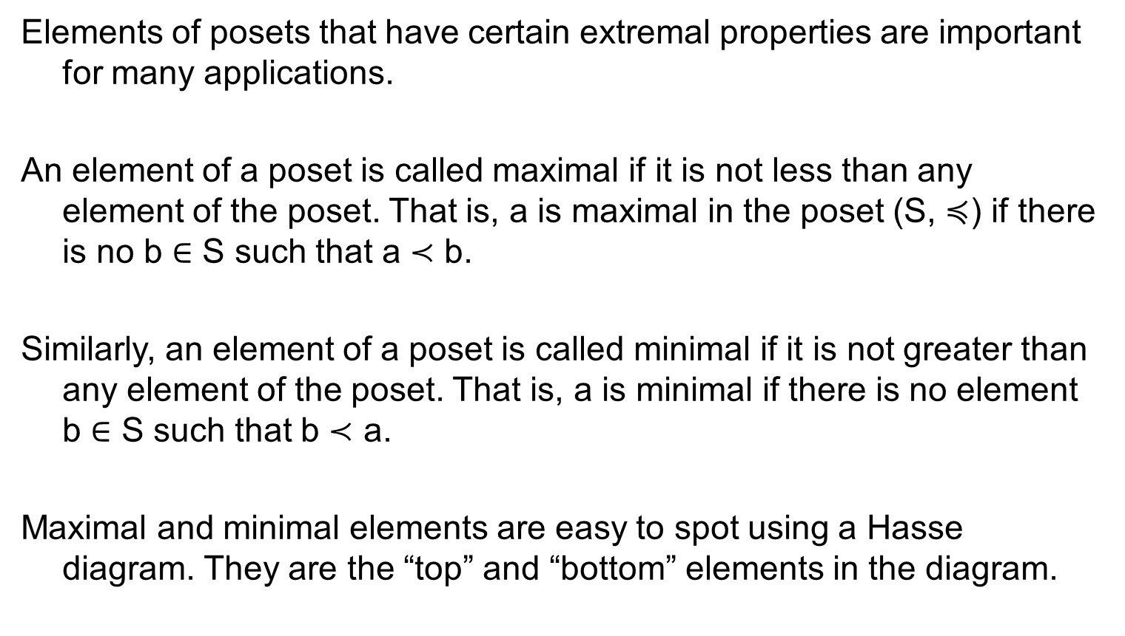
Maximal and minimal elements
Elements of posets that have certain extremal properties are important for many applications.
An element of a poset is called maximal if it is not less than any element of the poset. That is, a is maximal in the poset (S, $≼$) if there is no b ∈ S such that a ≺ b.
Similarly, an element of a poset is called minimal if it is not greater than any element of the poset. That is, a is minimal if there is no element b ∈ S such that b ≺ a.
Maximal and minimal elements are easy to spot using a Hasse diagram. They are the “top” and “bottom” elements in the diagram.

Slide 8
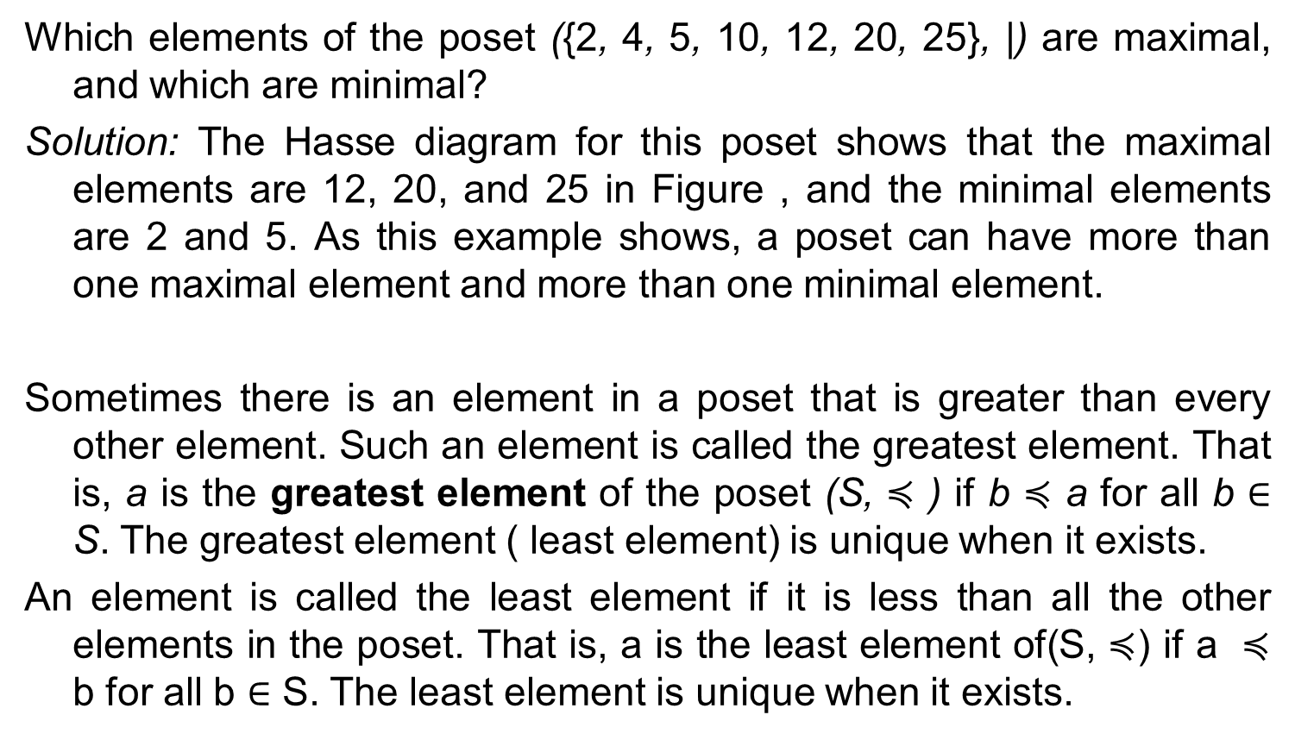
Example
Which elements of the poset ({2, 4, 5, 10, 12, 20, 25}, |) are maximal, and which are minimal?
Solution: The Hasse diagram for this poset shows that the maximal elements are 12, 20, and 25 in Figure , and the minimal elements are 2 and 5. As this example shows, a poset can have more than one maximal element and more than one minimal element.
Sometimes there is an element in a poset that is greater than every other element. Such an element is called the greatest element. That is, a is the greatest element of the poset (S, $≼$ ) if b $≼$ a for all b ∈ S. The greatest element ( least element) is unique when it exists.
An element is called the least element if it is less than all the other elements in the poset. That is, a is the least element of(S, $≼$) if a $≼$ b for all b ∈ S. The least element is unique when it exists.

Slide 9
Example
Is there a greatest element and a least element in the poset
(Z⁺ , |)?
Solution: The integer 1 is the least element because 1|n whenever n is a positive integer. Because there is no integer that is divisible by all positive integers, there is no greatest element.

Slide 10
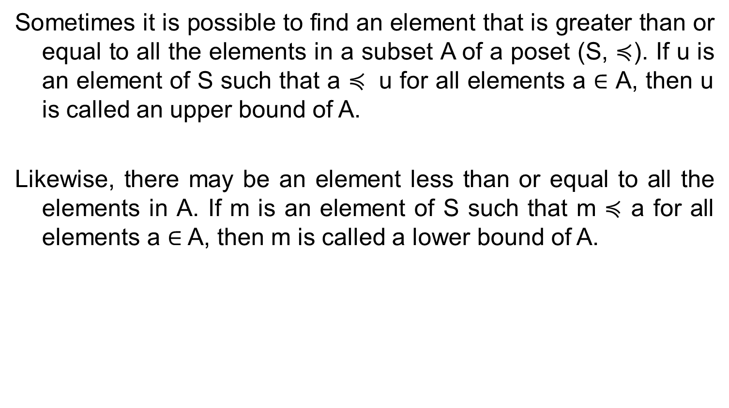
Upper and Lower bounds
Sometimes it is possible to find an element that is greater than or equal to all the elements in a subset A of a poset (S, $≼$). If u is an element of S such that a $≼$ u for all elements a ∈ A, then u is called an upper bound of A.
Likewise, there may be an element less than or equal to all the elements in A. If m is an element of S such that m $≼$ a for all elements a ∈ A, then m is called a lower bound of A.

Slide 11
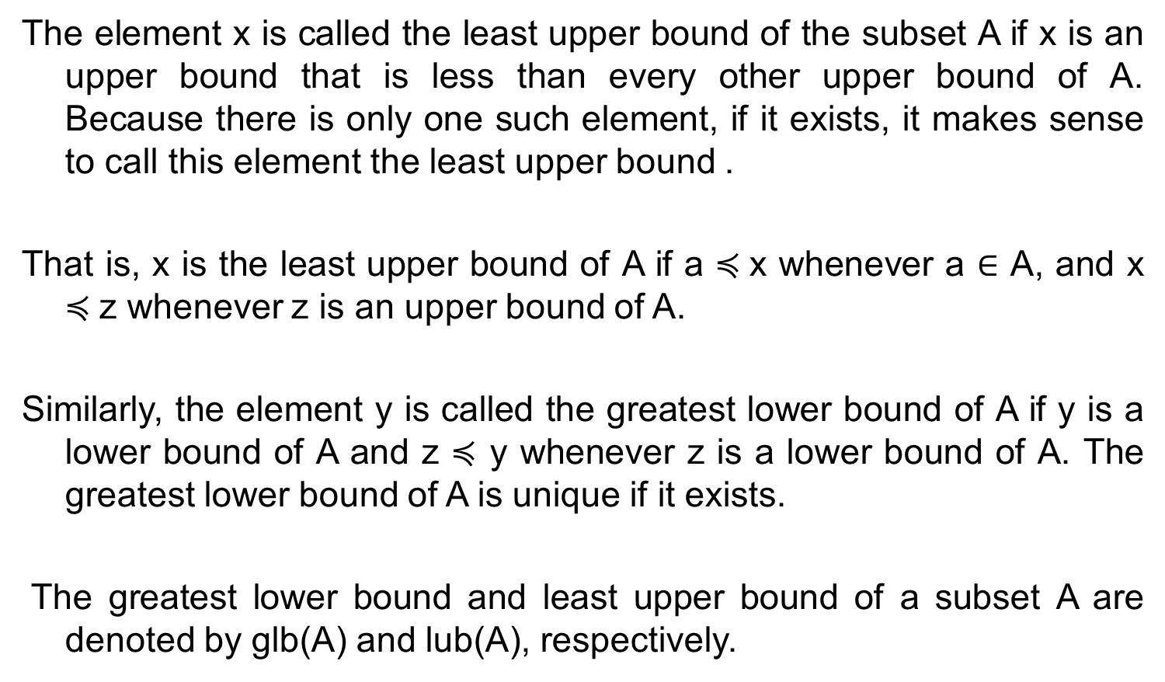
LUB and GLB
The element x is called the least upper bound of the subset A if x is an upper bound that is less than every other upper bound of A. Because there is only one such element, if it exists, it makes sense to call this element the least upper bound .
That is, x is the least upper bound of A if a $≼$x whenever a ∈ A, and x $≼$z whenever z is an upper bound of A.
Similarly, the element y is called the greatest lower bound of A if y is a lower bound of A and z $≼$ y whenever z is a lower bound of A. The greatest lower bound of A is unique if it exists.
The greatest lower bound and least upper bound of a subset A are denoted by glb(A) and lub(A), respectively.

Slide 12
*Find the lower and upper bounds of the subsets {a, b, c}, {j, h}, and {a, c, d, f } in the poset with the Hasse diagram.
Solution: The upper bounds of {a, b, c} are e, f, j, and h, and its only lower bound is a.
There are no upper bounds of {j, h}, and its lower bounds are a, b, c, d, e, and f .
The upper bounds of {a, c, d, f } are f , h, and j , and its lower bound is a.
*Find the greatest lower bound and the least upper bound of {b, d, g}, if they exist, in the poset.
The upper bounds of {b, d, g} are g and h. Because g ≺ h, g is the least upper bound.
The lower bounds of {b, d, g} are a and b. Because a ≺ b, b is the greatest lower bound.

Slide 13
Lattice
A partially ordered set in which every pair of elements has both a least upper bound and a greatest lower bound is called a lattice.
The posets represented by the Hasse diagrams in (a) and (c) are both lattices because in each poset every pair of elements has both a least upper bound and a greatest lower bound, as the reader should verify.

Slide 14
Solution
On the other hand, the poset with the Hasse diagram shown in (b) is not a lattice, because the elements b and c have no least upper bound. To see this, note that each of the elements d, e, and f is an upper bound, but none of these three elements precedes the other two with respect to the ordering of this poset.

Slide 15
Problem
Determine whether the relation with the directed graph shown is a partial order.
Find the duals of these posets. a) ({0, 1, 2}, ≤) b) (Z, ≥) c) (P (Z), ⊇) d) (Z+, |)
{(0, 0), (1, 0), (1, 1), (2, 0), (2, 1), (2, 2)} b) (Z, ≤) c) (P(Z), ⊆) d) (Z+, “is a multiple of”)

Slide 16
Problem
Answer these questions for the poset by drawing the Hasse diagram ({3, 5, 9, 15, 24, 45}, |).
a) Find the maximal elements.
b) Find the minimal elements.
c) Is there a greatest element?
d) Is there a least element?
e) Find all upper bounds of {3, 5}.
f ) Find the least upper bound of {3, 5}, if it exists.
g) Find all lower bounds of {15, 45}.
h) Find the greatest lower bound of {15, 45}, if it exists.

Slide 17
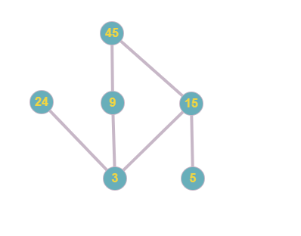
Solution

Slide 18
Sol..
Our maximal elements are 24 and 45.
Our minimal elements are 3 and 5.
There is no greatest element because this element would have to be a number that all other elements divide. Since our maximal elements are 24 and 45, and they do not divide each other, we do not have a greatest element.
There is no least element because this element would be a number that can divide all other elements. Since our minimal elements are 3 and 5, and they do not divide each other, we do not have a least element
15 and 45.
15.
3, 5, and 15.
15.

Slide 19
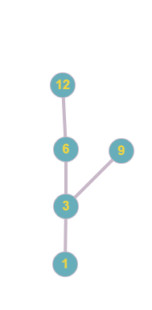
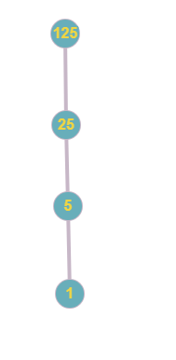
Problem
Determine whether these posets are lattices.
a) ({1,3,6,9,12},|) not a lattice because there are two maximal values
b) ({1,5,25,125},|) Lattice

Slide 20
Introduction to graph theory
Directed and undirected graphs
Handshaking theorem
Special graph structures
Graph representations

Slide 21
Real time applications of graphs
Graphs are used to represent the outcomes of round-robin tournaments.
to represent who influences whom in an organization,
to represent the outcomes of round-robin tournaments.
to model acquaintanceships between people, collaboration between researchers, telephone calls
between telephone numbers, and links between websites.
to model roadmaps and the assignment of jobs to employees of an organization.
it is possible to walk down all the streets in a city without going down a street twice
find the number of colors needed to color the regions of a map.
to determine whether a circuit can be implemented on a planar circuit board.
distinguish between two chemical compounds with the same molecular formula but different structures using graphs.
whether two computers are connected by a communications link using graph models of computer networks.
Graphs with weights assigned to their edges can be used to solve problems such as finding the
shortest path between two cities in a transportation network.
We can also use graphs to schedule exams and assign channels to television stations

Slide 22
Graphs

Slide 23
Graph
A graph G = (V ,E) consists of V , a nonempty set of vertices (or nodes) and E, a set of edges.
Each edge has either one or two vertices associated with it, called its endpoints.
An edge is said to connect its endpoints
A graph with an infinite vertex set or an infinite number of edges is called an infinite graph
A graph with a finite vertex set and a finite edge set is called a finite graph.

Slide 24
Definitions
A graph in which each edge connects two different vertices and where no two edges connect the same pair of vertices is called a simple graph.
Graphs that may have multiple edges connecting the same vertices are called multigraphs.
Edges that connect a vertex to itself. Such edges are called loops.
Graphs that may include loops, and possibly multiple edges connecting the same pair of vertices or a vertex to itself, are sometimes called pseudographs.

Slide 25
Definitions
A directed graph (or digraph) (V ,E) consists of a nonempty set of vertices V and a set of directed edges (or arcs) E. Each directed edge is associated with an ordered pair of vertices.
The directed edge associated with the ordered pair (u, v) is said to start at u and end at v.

Slide 26
Graph terminology

Slide 27
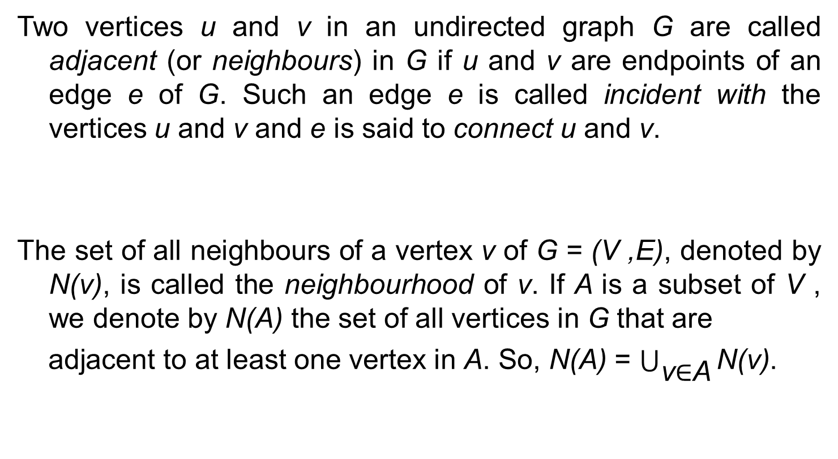
Definition
Two vertices u and v in an undirected graph G are called adjacent (or neighbours) in G if u and v are endpoints of an edge e of G. Such an edge e is called incident with the vertices u and v and e is said to connect u and v.
The set of all neighbours of a vertex v of G = (V ,E), denoted by N(v), is called the neighbourhood of v. If A is a subset of V , we denote by N(A) the set of all vertices in G that are
adjacent to at least one vertex in A. So, N(A) = $\bigcup_{\text{v}\text{∈}\text{A}}{\text{N}\text{(}\text{v}\text{)}}$.

Slide 28
Theorem
The degree of a vertex in an undirected graph is the number of edges incident with it, except that a loop at a vertex contributes twice to the degree of that vertex. The degree of the vertex v is denoted by deg(v).
An undirected graph has an even number of vertices of odd degree.
Show that the sum, over the set of people at a party, of the number of people a person has shaken hands with, is even. {Assume that no one shakes his or her own hand.}

Slide 29
Definition
When (u, v) is an edge of the graph G with directed edges, u is said to be adjacent to v and v is said to be adjacent from u. The vertex u is called the initial vertex of (u, v), and v is called the terminal or end vertex of (u, v). The initial vertex and terminal vertex of a loop are the same.
In a graph with directed edges the in-degree of a vertex v, denoted by deg−(v), is the number of edges with v as their terminal vertex. The out-degree of v, denoted by deg+(v), is the number of edges with v as their initial vertex. (Note that a loop at a vertex contributes 1 to both the in-degree and the out-degree of this vertex.)

Slide 30
Definition
A complete graph on n vertices, denoted by K_{n}is a simple graph that contains exactly one edge between each pair of distinct vertices.
A simple graph for which there is at least one pair of distinct vertex not connected by an edge is called noncomplete

Slide 31
Definitions
Cycles : A cycle C_{n}, n ≥ 3, consists of n vertices v1, v2,..., vn and edges {v1, v2}, {v2, v3},...,{vn−1, vn}, and {vn, v1}.
Wheels We obtain a wheel W_{n} when we add an additional vertex to a cycle C_{n}, for n ≥ 3, and connect this new vertex to each of the n vertices in Cn, by new edges.

Slide 32
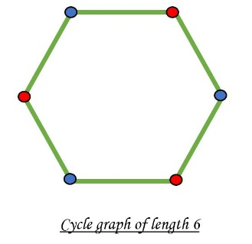
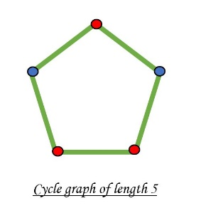
Definitions
A simple graph G is called bipartite if its vertex set V can be partitioned into two disjoint sets V₁ and V₂ such that every edge in the graph connects a vertex in V₁ and a vertex in V₂ (so that no edge in G connects either two vertices in V₁ or two vertices in V₂). When this condition holds, we call the pair (V₁, V₂) a bipartition. n of the vertex set V of G.
A simple graph is bipartite if and only if it is possible to assign one of two different colours to each vertex of the graph so that no two adjacent vertices are assigned the same colour.

Slide 33
Definitions
Complete Bipartite Graphs A complete bipartite graph K_{m,n} is a graph that has its vertex set partitioned into two subsets of m and n vertices, respectively with an edge between two vertices if and only if one vertex is in the first subset and the other vertex is in the second subset.

Slide 34
Definition
A subgraph of a graph G = (V,E) is a graph H = (W,F), where W ⊆ V and F ⊆ E. A subgraph H of G is a proper subgraph of G if H≠ G.
Let G = (V,E) be simple graph. The subgraph induced by a subset W of the vertex set V is the graph (W,F), where the edge set F contains an edge in E if and only if both endpoints of this edge are in W.
Given a graph G = (V,E) and an edge e ∈ E, we can produce a subgraph of G by removing the edge e. The resulting subgraph, denoted by G−e, has the same vertex set V as G. Its edge set is E−e. Hence, G−e = (V,E−{ e}).

Slide 35
Definition
We can also add an edge e to a graph to produce a new larger graph when this edge connects two vertices already in G. We denote by G+e the new graph produced by adding a new edge e, connecting two previously non incident vertices, to the graph G Hence, G+e = (V,E∪{ e}).
The union of two simple graphs G1 = (V1,E1) and G2 = (V2,E2) is the simple graph with vertex set V1∪V2 and edge set E1∪E2. The union of G1 and G2 is denoted by G1∪G2.

Slide 36
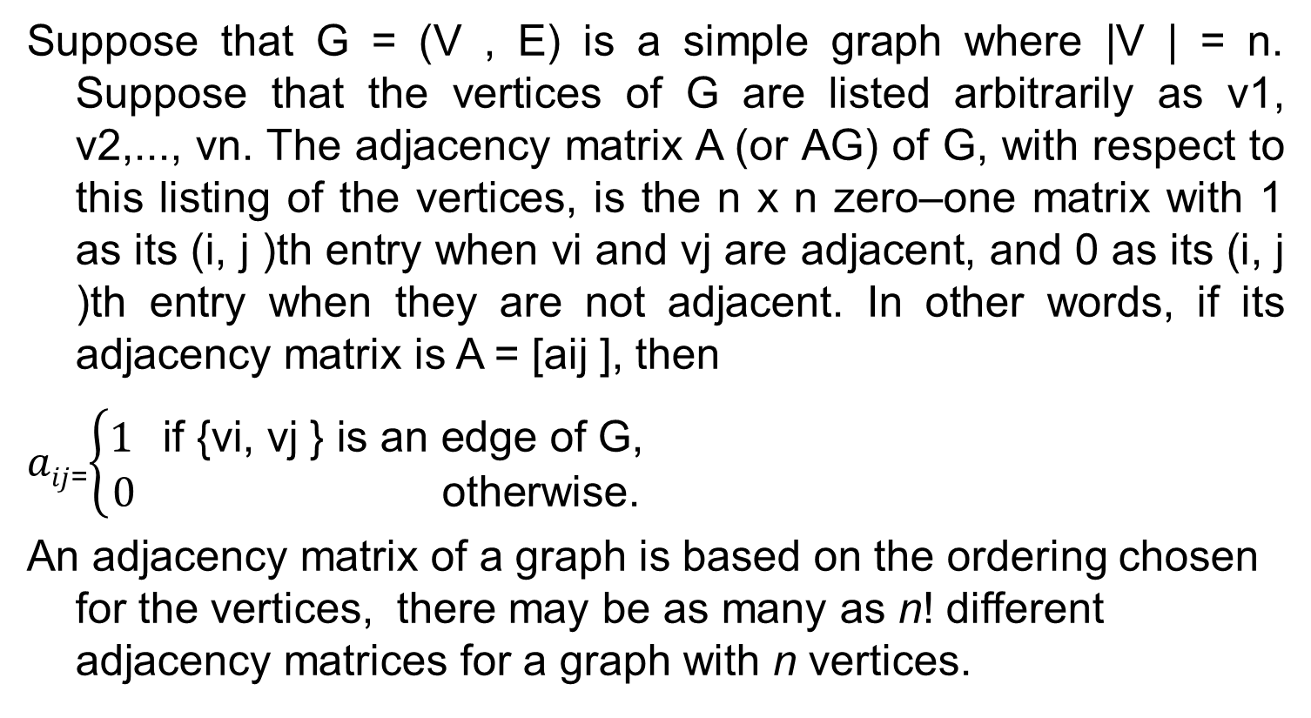
Definitions
Suppose that G = (V , E) is a simple graph where |V | = n. Suppose that the vertices of G are listed arbitrarily as v1, v2,..., vn. The adjacency matrix A (or AG) of G, with respect to this listing of the vertices, is the n x n zero–one matrix with 1 as its (i, j )th entry when vi and vj are adjacent, and 0 as its (i, j )th entry when they are not adjacent. In other words, if its adjacency matrix is A = [aij ], then
$aij$₌$\left\{\begin{aligned}\text{1 }\text{if}\text{ \{}\text{vi}\text{, }\text{vj}\text{ \} }\text{is} \text{an} \text{edge} \text{of} \text{G}\text{,} \\ 0 \text{otherwise}\text{.}\end{aligned}\right.$
An adjacency matrix of a graph is based on the ordering chosen for the vertices, there may be as many as n! different adjacency matrices for a graph with n vertices.

Slide 37
Definitions
The adjacency matrix of a simple graph is symmetric, that is, aij = aji, because both of these entries are 1 when vi and vj are adjacent, and both are 0 otherwise.
Furthermore, because a simple graph has no loops, each entry aii, i = 1, 2, 3,...,n, is 0.
Adjacency matrices can also be used to represent undirected graphs with loops and with multiple edges.

Slide 38
Definitions
A loop at the vertex vi is represented by a 1 at the (i, i)th position of the adjacency matrix.
When multiple edges connecting the same pair of vertices vi and vj , or multiple loops at the same vertex, are present, the adjacency matrix is no longer a zero–one matrix, because the (i, j )th entry of this matrix equals the number of edges that are associated to {vi, vj }.
All undirected graphs, including multigraphs and pseudographs, have symmetric adjacency matrices.

Slide 39
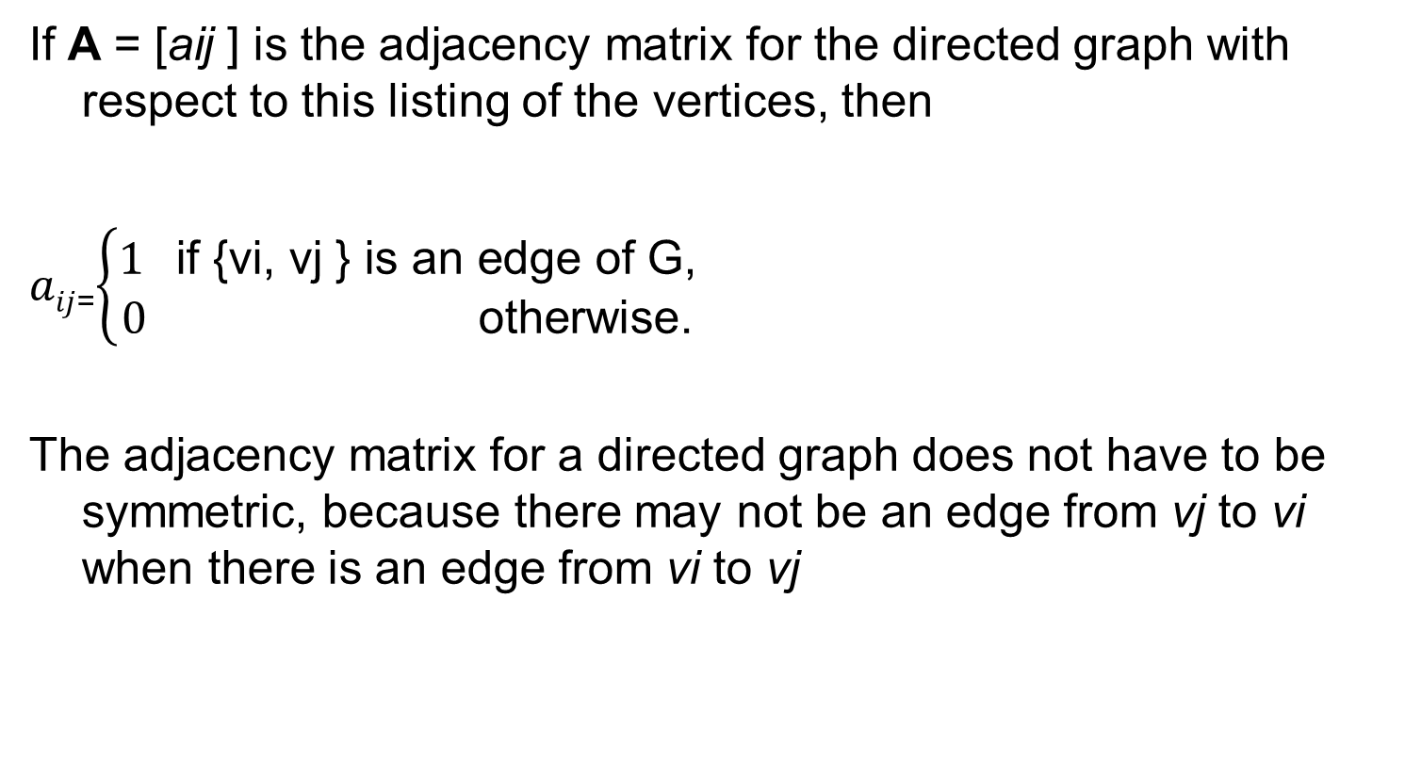
Definitions
If A = [aij ] is the adjacency matrix for the directed graph with respect to this listing of the vertices, then
$aij$₌$\left\{\begin{aligned}\text{1 }\text{if}\text{ \{}\text{vi}\text{, }\text{vj}\text{ \} }\text{is} \text{an} \text{edge} \text{of} \text{G}\text{,} \\ 0 \text{otherwise}\text{.}\end{aligned}\right.$
The adjacency matrix for a directed graph does not have to be symmetric, because there may not be an edge from vj to vi when there is an edge from vi to vj

Slide 40
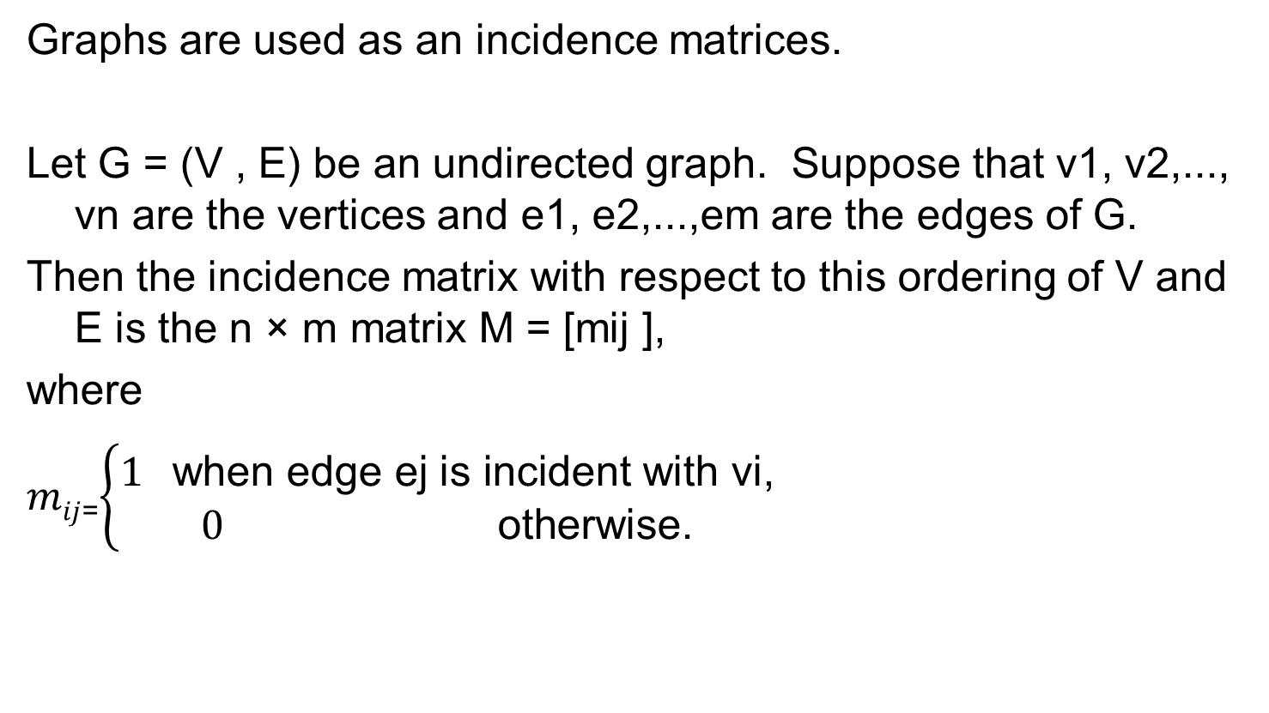
Definitions
Graphs are used as an incidence matrices.
Let G = (V , E) be an undirected graph. Suppose that v1, v2,..., vn are the vertices and e1, e2,...,em are the edges of G.
Then the incidence matrix with respect to this ordering of V and E is the n × m matrix M = [mij ],
where
$mij$₌$\left\{\begin{aligned}\text{1} \text{when} \text{edge} \text{ej} \text{is} \text{incident} \text{with} \text{vi}\text{,} \\ 0 \text{otherwise}\text{.}\end{aligned}\right.$

Slide 41
Problems
Determine whether the graph shown has directed or undirected edges, whether it has multiple edges, and whether it has one or more loops.
This graph has directed edges, multiple edges, and two loops. This is a Directed Multigraph.
Is the graph simple, if not simple, find a set of edges to remove to make it simple.

Slide 42
Problem
The intersection graph of a collection of sets A1, A2,...,An is the graph that has a vertex for each of these sets and has an edge connecting the vertices representing two sets if these sets have a nonempty intersection. Construct the intersection graph of these collections of sets.

Slide 43
Problem
Draw an undirected graph represented by the given adjacency matrix.

Slide 44
Problem
Construct the underlying undirected graph for the graph
with directed edges in

Slide 45
Definitions
Determine the number of vertices and edges and find the in-degree and out-degree of each vertex for the given directed multigraph.
edges = 13, sum of deg in = 6 + 1 + 2 + 4 + 0 = 13
sum of deg out = 1 + 5 + 5 + 2 + 0= 13
Determine the sum of the in-degrees of the vertices and the sum of the out-degrees of the vertices directly. Show that they are both equal to the number of edges in the graph.

Slide 46
Problem
Draw these graphs.
a) K₇ b) K_{1,8} c) K_{4,4} d) C₇
e) W₇
How many vertices and how many edges do these graphs have?
a) K_{n} b) C_{n} c) W_{n} d) K_{m,n}

Slide 47
Problem
For which values of n are these graphs bipartite?
a) K_{n} b) C_{n} c) W_{n}
K₁ is bipartite if we allow one of the sets to be empty.
K₂ is bipartite because we can let one vertex be in V1 and the other vertex to be in V2.
K_{n} for n ≥ 3 is not bipartite: choose any 3 vertices. They all are pairwise connected, therefore there is no way to partition them into two disjoint sets V1 or V2 such that there are no edges within V1 and no edges within V2.

Slide 48
Solution
C_{n} is bipartite if and only if n is even.
Label the vertices by 1, 2, ... consecutively along the cycle. If vertex 1 is in V1 then vertex 2 must be in V2, vertex 3 must be in V1, vertex 4 must be in V2, and so on. All vertices with odd number are in V1 and all vertices with even number are in V2. The last vertex is in V1 if n is odd and it is in V2 if n is even. But it is connected to vertex 1. We see that if n is odd, the graph is not bipartite, and if n is even, the graph is bipartite.
Wn is not bipartite for any value of n, since the center vertex is adjacent to every other vertex in the graph. This is shown in the example to the left with W6.

